Slide 1
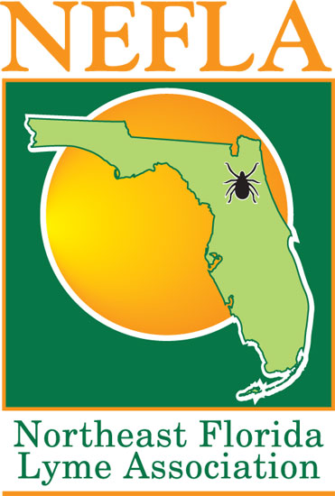
Lyme Disease Prevention And Education
Notes:
I want to inform you about Lyme Disease
The three key areas I will cover are:
Education
Prevention
&
Treatment

Slide 2
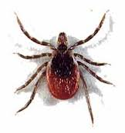
Lyme Disease Overview
Lyme disease (LD) is an infection caused
by Borrelia burgdorfer – Bb.
Bb is a type of bacterium called a spirochete.
A spirochete is shaped like a cork screw.
Black Legged ticks carry the Bb bacterium and transmit it to their hosts – humans and animals.
Once the Bb bacterium is transmitted it can cause a number of different symptoms.
Notes:
Lyme Disease LD is caused by Bor-rel-ia Burg-dorfer Bb
Bb is a Spy-ro-keet bacterium
It is shaped like a screw [point to the spy-or-keet]
The screw like structure of the Spy-or-keet allows the bacterium to penetrate various organs and parts of the human body
5. Black legged ticks which include deer ticks are found in Florida, Georgia, and all other states.

Slide 3
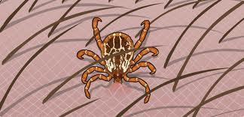
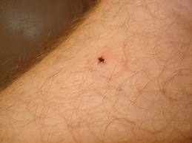
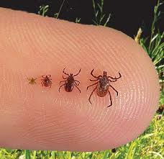
How Lyme Is Transmitted
Lyme is transmitted to
humans through a tick bite.
Black Legged Ticks
carry the bacterium that causes LD.
Ticks that are positive for the Bb bacterium have been found all over the US.
Notes:
LD is transmitted by ticks.
However, some researchers have found that the Bb bacterium have also been transmitted by fleas and mosquitoes.
3. Ticks carrying Bb have been found all over the US – INCLUDING RIGHT HERE IN GREATER JACKSONVILLE! Including our back yards and common camping and hiking areas.
4. Since Bb carrying ticks are where we play, work, camp and hike we need to prevent tick bites

Slide 4
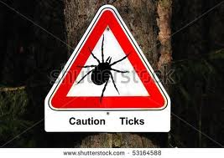
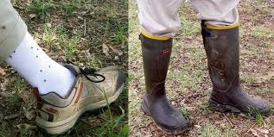
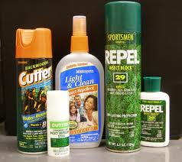
How To Prevent A Tick Bite
Stay on clear trails and avoid wooded
areas and low lying brush.
Wear closed-toed shoes and tuck pants into shoes/boots/socks.
Wear light colored clothing.
Use repellent containing DEET or Permethrin.
Check for ticks frequently.
Remove ticks promptly.
Notes:
Staying on clear trails and avoiding wooded areas is not always the fun thing to do.
If you feel so inclined to venture off of trails make sure you take
ALL SUGGESTED PREVENTIONS AGAINST GETTING BITTEN BY A TICK.
1. Wear white high socks
Wear light colored long light weight pants
Tuck your pants into your socks
4. Wear closed toe shoes (boots are most advisable and the higher up the leg the better)
5. Use bug repellent containing DEET or Permethrin

Slide 5
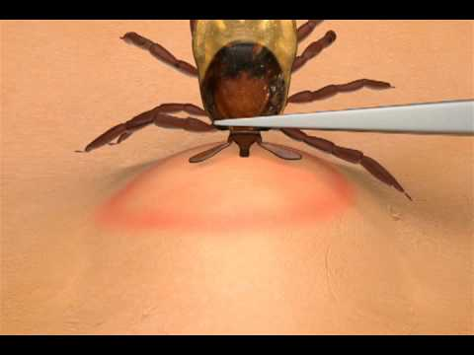
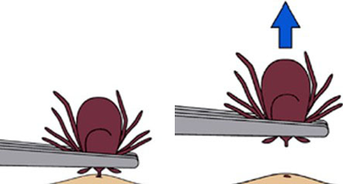
What To Do If You Get A Tick
Do not panic and keep calm.
Wipe the tick bite area with an alcohol wipe.
Grab the tick as close to its mouth with a pair of tweezers.
Gently pull the tick straight
up until it lets go of your skin.
Wipe the area with the alcohol wipe.
Circle the bite mark with a marker.
Notes:
1. If you see a tick crawling on your clothing brush it off --- DON’T WAIT.
2. If the tick is attached to your skin SOMEONE to assist you in removing the tick and if available locate a TICK KIT.
3 TICK KIT [pull out the contents one at a time]:
alcohol wipes;
b. A pair of tweezers;
c. A plastic bag (should also have one in your personal camp gear); and
d. A permanent marker.
4 Steps to Remove Tick
Wipe the bite area with an alcohol wipe
b. With your finger lift the body of the tick up so it is perpendicular to the surface of the skin
c. Using a pair of tweezers (good quality) grab the mouth/head of the tick as close to the skin as possible
d. Once you have a secure grip on the mouth/head of the tick -- pull straight up in a gently steady motion until the tick is removed
Drop the tick into the plastic bag (it is still alive)
Wipe the bite area with an alcohol wipe and mark the bite area with the permanent marker
Label the bag with your name, date, and location where you picked up the tick with the permanent marker
h. Once home, notify your parents that a tick was removed and give them the bag with the tick
i. Monitor for symptoms (discussed later)

Slide 6
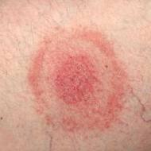
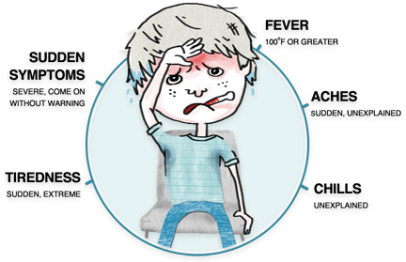
Symptoms Of Acute Lyme Disease
Early symptoms of LD can be mild and overlooked and include the following:
A bulls-eye rash may or may not appear.
Swelling of lymph glands near the tick bite.
Flu like symptoms (joint pains, chills, fever, & fatigue).
Generalized achiness.
Headache.
Notes:
1 If you or someone with you found an attached tick be sure to monitor for symptoms
2 Remember you could have been bitten and the tick could have fallen off without you even knowing it or you might not find it before symptoms are seen
3 Be on alert for the following symptoms:
a. A bulls-eye rash (it is thought that less than 50% of people who have been bitten and who are infected experienced a bulls-eye rash)
b. Swelling of lymph nodes near the bite the area. So if you were bitten behind the ear you may experience swelling of the nodes in your neck
c. Flu like symptoms such as chills, fever, feeling tired, achy, headache, loss of appetite
d. If you experience any of these symptoms you should contact a Lyme literate physician

Slide 7
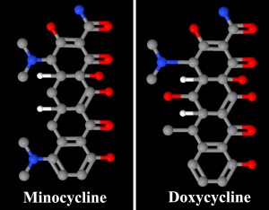
Testing For Acute Lyme Disease
Lyme disease is frequently misdiagnosed.
Lab tests for LD are not reliable.
Not all physicians are aware of the prevalence of LD.
Suggested treatment is antibiotic treatment for six to ten weeks.
Commonly used antibiotic for LD treatment include doxycycline or minocycline.
Notes:
1 LD is hard to diagnose and therefore it is key to find a Lyme literate doctor.
2 There is a list of resources at the end of this presentation. These resources will provide information where to seek additional help and guidance including how to locate a Lyme literate doctor in your area.
3 Diagnosing LD is not as simple as ordering a certain blood test or an x-ray it includes understanding the bodies reaction to the bacterium and how to test for the various reactions.
4 Bb is a bacteria therefore it can be treated with antibiotics
5 A Lyme literate physician will develop the best treatment plan for you

Slide 8
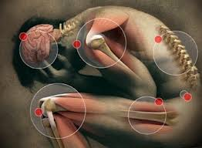
What Is Chronic Lyme Disease
If left untreated after exposure, the physical structure of the Bb bacterium enables the bacterium to penetrate parts of the body hard to treat such as the brain.
LD is frequently misdiagnosed,
many individuals don’t realize
they have been bitten by a tick.
The symptoms of chronic LD
mimic other more common
diseases.
Notes:
1 If acute LD is left untreated it will morph into chronic LD – chronic LD is when the bacterium has reached different areas of your body and has multiplied and the bacterium can cause mild to severe symptoms.
2 Chronic LD is harder to treat than acute LD because the stealth Spy-ro-keet bacteria have had an opportunity to set up home in hard to reach places such as your brain, heart, muscles, joints, glands, and other areas
3 Acute LD morphs into chronic Lyme because we are unaware of acute LD and not all practicing physicians realize LYME is in FLORIDA.
4 Once people are educated about Acute LD and take steps to prevent it and get immediate medical treatment then the number of chronic LD cases will go down.
5 In my mind chronic Lyme is similar to skin cancer from over exposure to UV rays overtime –
once the public became aware that over exposure to UV rays from the sun could cause skin cancer
people started using sun screen to prevent over exposure, and
they watched for early signs of skin cancer, and
sought early medical attention.
6 Chronic Lyme can be reduced or eliminated once the public is aware they are exposed to it
7 Lyme is in Florida and therefore the public:
needs to be educated and aware of the exposure
Wear protective clothing
Use bug repellent
Watch for signs and symptoms of acute LD, and
Seek immediate medical treatment from a Lyme literate physician

Slide 9
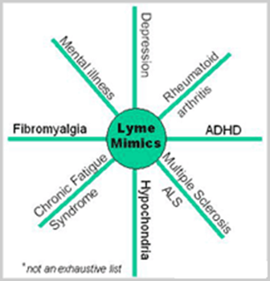
What Is Chronic Lyme Disease (cont.)
LD is sometimes referred to as “The Great Imitator” because it can virtually imitate symptoms of any disease such as:
MS
ALS
Chronic Fatigue Syndrome
Fibromyalgia
Rheumatoid Arthritis
Autism
Alzheimer’s
Parkinson’s
ADD / ADHD
Notes:
LD is the GREAT IMITATOR
A sample of chronic illnesses that Lyme mimics are:
Multiple Sclerosis
Lou Garrigs Disease (ALS)
Chronic Fatigue Syndrome
Fibromyalgia
Rheumatoid Arthritis
Autism
Alzheimer’s
Parkinson’s
ADD/ADHD

Slide 10
Facts And Fallacies
Facts | Fallacies
Lyme is prevalent throughout the U.S. | There is no Lyme in Florida.
Lyme disease is the most widespread vector-borne disease in the U.S. and it is a major problem worldwide. | 100% of patients will recall a tick bite. Also 100% have an bulls-eye-rash.
Lyme disease is hard to diagnose. | The best way to take off a tick is burn it off.
Notes:
There are many fallacies out there about Lyme and these include:
THERE IS NO LYME IN FLORIDA - This is absolutely not true and has been proven
If you didn’t get a bulls-eye rash then you don’t have Lyme
If the tick was on you for less than 24 hours then you don’t have Lyme – Once a tick carrying Bb bites you the bacteria can enter your body
There are many myths about how best to remove a tick including burning it so it will release -- this method could cause the tick to release more bacteria into your system. ---- The method described in this presentation is the approved method by Northeast Florida Lyme Association

Slide 11
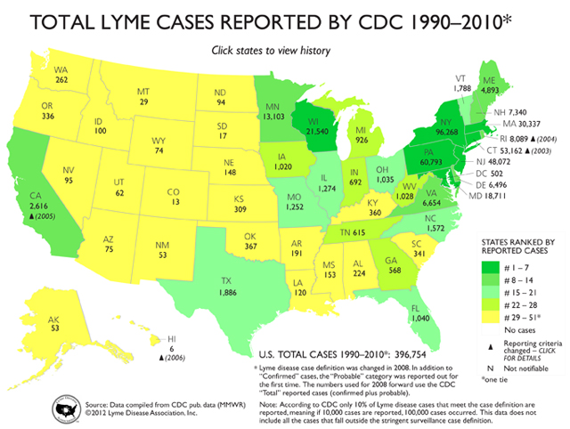
Lyme Map
Notes:
This reports only 1,040 documented cases of Lyme disease in Florida in 20 years -- SO WHAT IS THE BIG DEAL and is there a need to take precautions?
YES – The CDC only has reported documented cases and this data doesn’t include cases that fall outside the stringent surveillance case definition
Some experts believe that 10x as many cases occurred compared to reported.
If you have been exposed to ticks, whether you found one or not, and you have any of the symptoms listed above find a Lyme literate physician and let them confirm whether or not you have been infected.

Slide 12
Prevention, Education & Treatment
Prevention
Wear protective light colored clothing.
Use bug repellant containing DEET or Permethrin.
Remove and save the tick.
Education
Know the early signs & symptoms of LD.
Treatment
Seek medical advise and treatment from a Lyme literate physician.
Notes:
In summary
There are three key points:
1 Prevention
2 Education
3 Treatment
Prevention
- Wear protective light colored clothing
- Always apply bug repellent prior to doing yard work, camping, hiking, etc.
- Purchase bug repellent that contains DEET or Permethrin
- Have a tick kit on hand (available for a small fee from FEMA while supplies last)
- Remove and save the tick
Education
- Know the early signs and symptoms of LD
Treatment
- Find a Lyme literate physician and established yourself as a patient
- If you have been exposed to ticks and symptoms develop seek medical attention from the physician
- Take the tick with you to the doctor they will director you on what you should do with it

Slide 13
References
Northeast Florida Resource
http://northeastfloridalymeassociation.org
Tick-testing labs
IGeneX Labs, Palo Alto, CA: 800-832-3200
MDL, Mt. Laurel, NJ: 877-269-0090
NJ Labs, New Brunswick, NJ: 732-249-0148
Lyme Literate Physician Finder
http://module.lymediseaseassociation.org/referral/LogIn.php

Slide 14
Credits
http://northeastfloridalymeassociation.org
http://www.ilads.org
http://aldf.com
http://module.lymediseaseassociation.net

